Slide 1
UML Class Diagrams
Database System Lab

Slide 2
Outline
Using UML for database design
UML notations

Slide 3
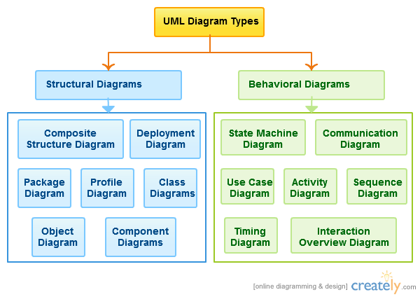
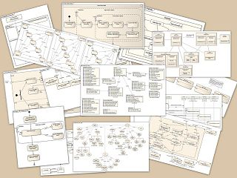
UML Components

Slide 4
Elements of Class Diagram
Class and attributes
Similar to struct and fields in a struct
Relationships
Association
Aggregation
Composition
Inheritance

Slide 5
Class and attributes
Course
Class name
Course_name
Class_room
Course_credits
Attributes
Generally no methods in conceptual database designs
Data types may be added as part of refinement

Slide 6
Association
Association name
Course
Instructor
Course_name
Class_room
Course_credits
Instr_name
Office
e_mail
n
Courses_taught
1
1
teacher
Cardinality
Role name (optional)

Slide 7
Association cardinality
One-to-one (written as 1:1)
One-to-Many (written as 1:n)
Many-to-Many (written as m:n)
Course
Instructor
Course_name
Class_room
Course_credits
Instr_name
Office
e_mail
Courses_taught
1
teacher
What is the interpretation of various cardinalities?

Slide 8
One-to-one (written as 1:1)
Course
Instructor
Course_name
Class_room
Course_credits
Instr_name
Office
e_mail
1
Courses_taught
1
teacher
The two sentence rule:
EVERY course is taught by ONE Instructor
EVERY Instructor teaches ONE Course

Slide 9
One-to-many (written as 1:n)
Course
Instructor
Course_name
Class_room
Course_credits
Instr_name
Office
e_mail
1
Courses_taught
n
teacher
The two sentence rule:
EVERY course is taught by MANY Instructors
EVERY Instructor teaches ONE Course

Slide 10
Many-to-one (written as n:1)
Course
Instructor
Course_name
Class_room
Course_credits
Instr_name
Office
e_mail
n
Courses_taught
1
teacher
The two sentence rule:
EVERY course is taught by ONE Instructor
EVERY Instructor teaches MANY Courses

Slide 11
Aggregation (HAS-A)
Cardinality
Computer
Peripheral
Serial_No
Make
Peripheral_name
n
Unfilled diamond placed on container class
Parent class
Container class
Child class
Computer has-a peripheral

Slide 12
Aggregation (HAS-A)
Aggregation is similar to association
The association name is fixed to “HAS-A”
Cardinality cannot be “many:many”
Child can exist independently until attached to a parent

Slide 13
Composition (IS-PART-OF)
Cardinality
Computer
Peripheral
Serial_No
Make
Peripheral_name
n
Filled diamond placed on container class
Parent class
Container class
Child class
Peripheral is-part-of computer

Slide 14
Composition (IS-PART-OF)
Composition is similar to Aggregation
The relationship name is fixed to “IS-PART-OF”
Cardinality cannot be “many:many”
Child CANNOT exist independently until attached to a parent (“existence dependency”)
Deletion semantics – All child objects get deleted when parent is deleted

Slide 15
Inheritance (IS-A)
Student
SID
Name
GPA
Super class
Open triangle
TA
Research Engg
Hours_clocked
Project_name
Sub-classes
A student can be either a TA or research engineer or neither

Slide 16
Inheritance (IS-A)
The relationship name is fixed to “IS-A”
Child object inherits all attributes of parent objects
Class hierarchy can be arbitrarily deep
Cardinality
  cannot be “one:many”
  cannot be “many:many”
  Cardinality can only be 1:1 or 1:0
  So no need to (and must not) mention cardinality

Slide 17
Partitioned subclasses
Parent object cannot exist stand-alone
Every student MUST be either a TA or research engineer
Student
SID
Name
GPA
Filled triangle
TA
Research Engg
Hours_clocked
Project_name

Slide 18
Describe class diagram in one page!
Pre_Req
Course
Instructor
Skill
Experience
Course_name
Class_room
Course_credits
Instr_name
Office
e_mail
1
1
m
Enrolled_courses
course_assisted
n
Enrolled_students
Student
Every piece of information (every word and letter!) found in this diagram must find a place in your description
SID
Name
GPA
assistant
1
TA
Research Engg
Hours_clocked
Project_name

